Slide 1

PROJECT PRESENTATION
AI-Based Phishing Detection with Cloud and Database Logging
Under the guidance of :
Bidisha Goswami
Presented by:
Priya Devi(02)
Wahengbam Gonet Singh(18)

Slide 2




What Is Phishing?
Understanding the threat this project is built to detect
01
02
03
A fraudulent attempt
A convincing fake
A social attack
Usually made through email, to steal a person's sensitive personal information.
A web page designed to act on behalf of a trusted third party, tricking the viewer into trusting a fraudulent source.
Socially engineered to persuade users, via electronic channels, into performing actions that benefit the attacker.
Royal Global University • Guwahati
2

Slide 3






Objectives
What the system is designed to achieve
Detect phishing URLs using machine learning techniques
Analyze URL features and explain why a URL is classified as phishing or legitimate.
Provide users with real-time phishing detection results
Allow users to create accounts and view their scan history.
Display phishing analytics and provide an admin panel for monitoring trends.
Deploy the system on cloud platforms for accessibility
Royal Global University • Guwahati
3

Slide 4




Technical Feasibility
Why the proposed system is practical to build and deploy
Machine Learning Model
Web Application Development
Cloud Database
Use Python and Scikit-learn to train a phishing URL classification model using features extracted from URLs
Use Flask to develop the web application, including URL scanning, user registration, login, and result display.
Use a cloud database to securely store scan results, user accounts, timestamps, and scan history
Explainable Results
Dashboard & Admin Panel
Online Deployment
The system can show important URL features and reasons, such as suspicious symbols, excessive URL length, or missing HTTPS, to explain the prediction
Use HTML, CSS, Bootstrap, and JavaScript to create dashboards for scan analytics and an admin panel for monitoring phishing trends
The application can be deployed on cloud hosting platforms, making it accessible online for demonstration and testing
Royal Global University • Guwahati
4

Slide 5

Methodology
End-to-end pipeline, from raw data to live prediction
1
2
3
4
5
6
Dataset
Feature Extraction
ML Training
Backend (Flask)
Dashboard & Analytics)
Cloud Deployment
ML Training
Collect and preprocess phishing and legitimate URL datasets.
Extract URL length, special symbols, domain and security features.
Train and compare SVM, Random Forest & Gradient Boosting using Scikit-learn.
Process user requests, perform predictions, and manage user authentication..
Display scan history, phishing statistics, and trends for users and admins
Deploy the web application and ML model using free cloud hosting for online access.
Train and compare SVM, Random Forest & Gradient Boosting using Scikit-learn.
Royal Global University • Guwahati
6

Slide 6
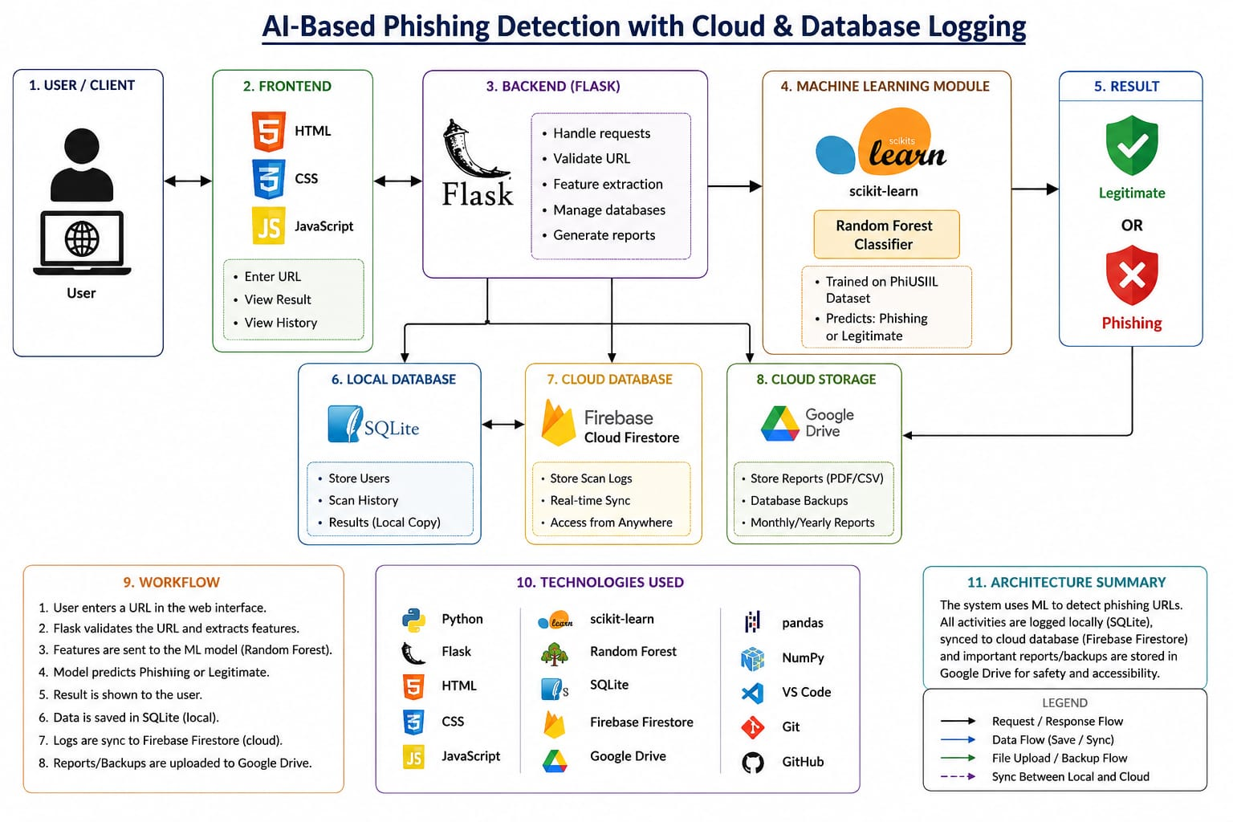
Royal Global University • Guwahati
2

Slide 7
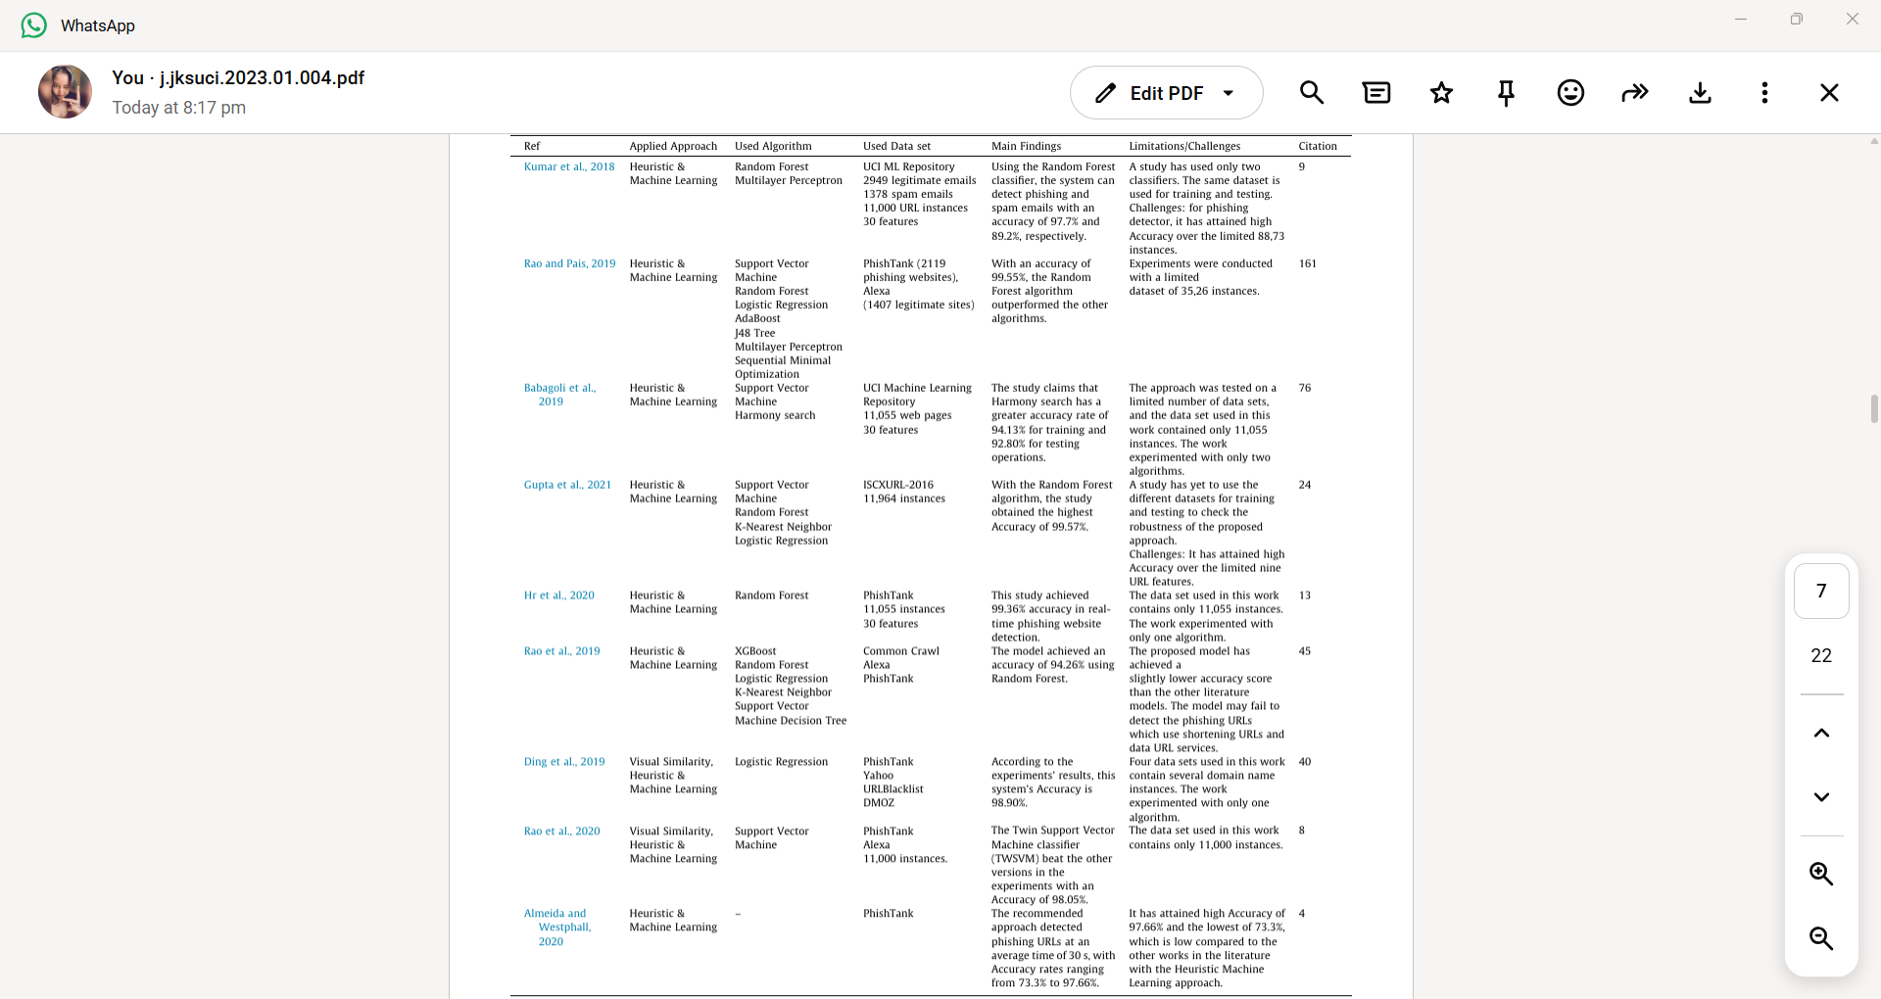
Royal Global University • Guwahati
2

